Slide 1
SHRM – Berks County
Talent Acquisition and Retention

Slide 2
Talent Acquisition & Retention
The Current Reality

Slide 3
The Current Reality
Automation AI/ML
Unemployment 4.1%
Demographic Trends
Inflation 6.5%
Labor Participation Rate 62.1%
Wage Growth 6.2%
Skills Gap
Immigration Policy
Social Media
Quiet Quitting
Childcare Access & Affordability
Remote/Hybrid 8/10
Social Awareness
Economic Recession
Gig Economy 59,000,000
Quit Rate
4M per month

Slide 4
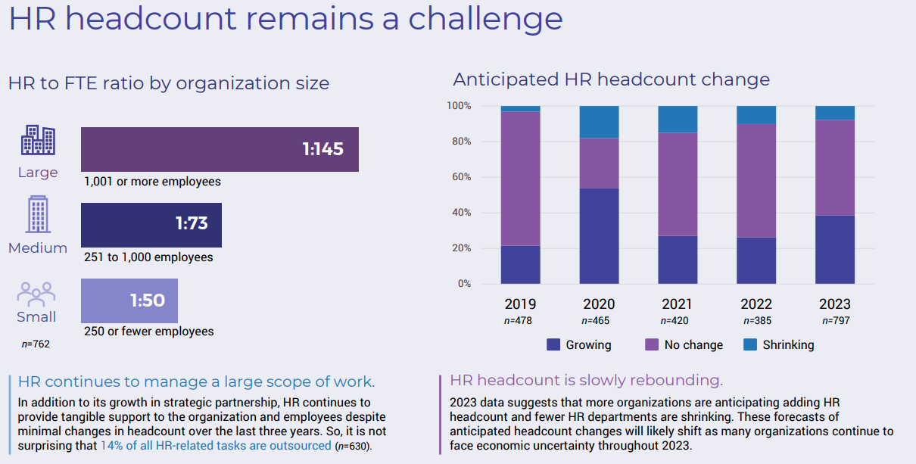
The Current Reality

Slide 5
The Current Reality
What does it mean?
HR leadership has never been as important to organizational success as it is today
Our core purpose of attracting, retaining, and developing people has NOT changed
BUT….
Today
People are a scarce resource
They don’t come with the skills we need
Expectations and challenges are high
Bottom line – there has never been a better OR harder time to be an HR professional.
THANK YOU!

Slide 6
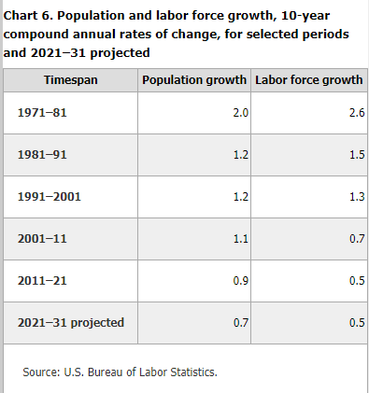
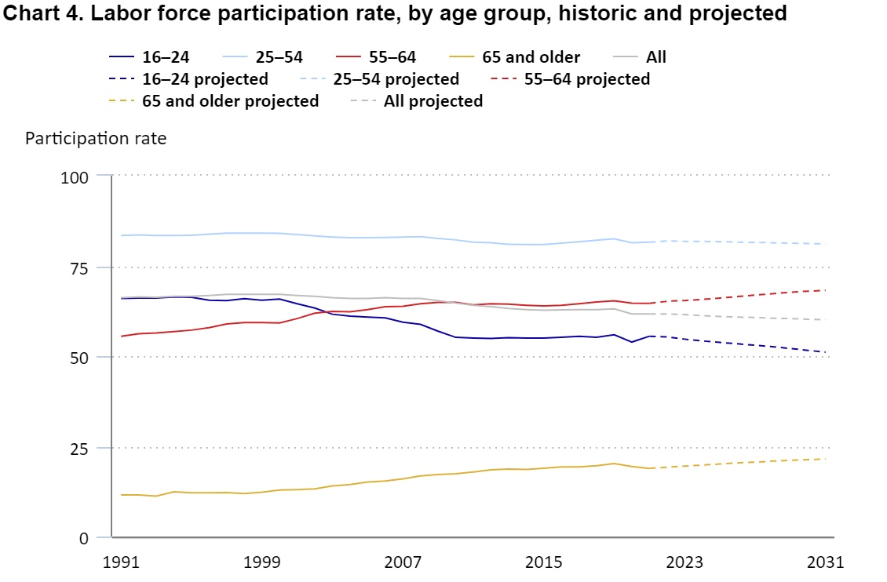
The Current Reality – Big Picture
Labor scarcity will increase further
2019: 63.1%
2021: 61.7%
2031: 60.1%
Participation Rates are declining
Labor Force Growth rate has slowed

Slide 7
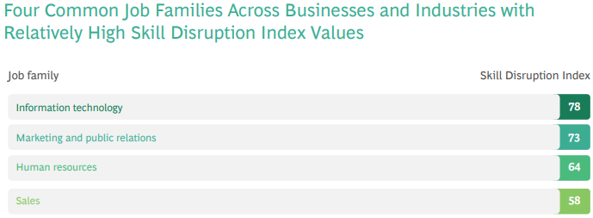
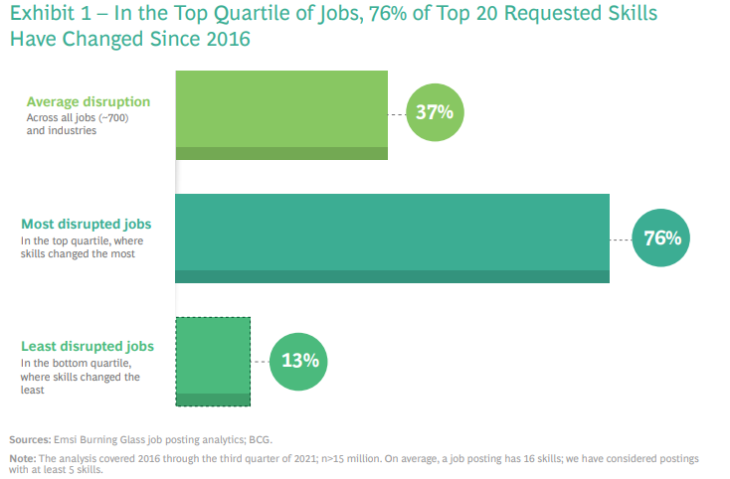
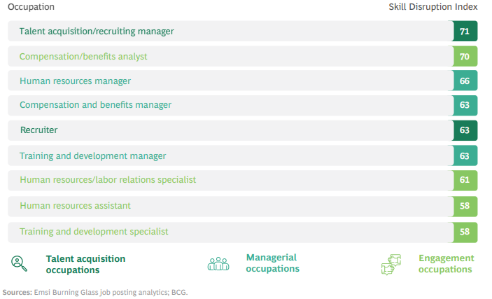
The Current Reality – Big Picture
Skill gap will grow - disruption

Slide 8
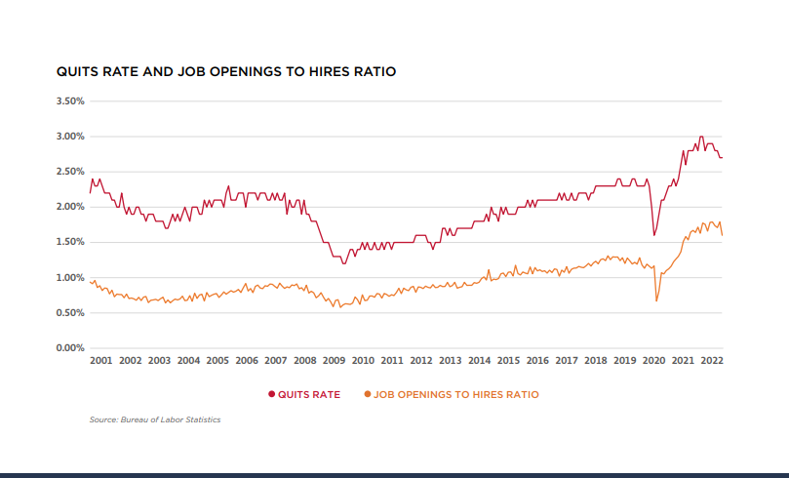
The Current Reality
Quit rates continue….over 4,000,000 (2.7%) every month

Slide 9
The Current Reality – Big Picture
Today’s Mindset
It’s no longer about creating jobs for workers, it’s now about creating workers for jobs
HR in the spotlight!
Keeping
Attracting
Growing

Slide 10
Talent Strategy
Attracting Talent in today’s reality

Slide 11
Talent Strategy - Attraction
Talent Attraction TIPS
Start with the BASICS – Total Rewards
Market-Validated Base Pay Structure
Performance-Based Incentive Structure
Fair and Clear Wage Administration Process (progression, promotions, transfers, etc..)
Benefits
Health and Welfare
Retirement – minimum 3% company contribution
Student Loan 401K matching (Secure Act 2.0)
Time-Off benefits

Slide 12
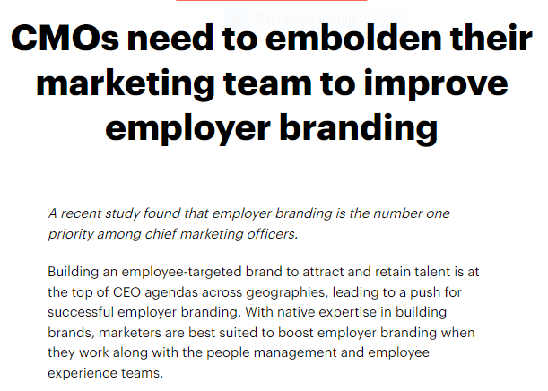
Talent Strategy - Attraction
Talent Attraction TIPS
Build a compelling and genuine message
Recruiting = Sales/Marketing
WHY YOU?

Slide 13
Talent Strategy - Attraction
Talent Attraction TIPS
Workforce Planning – (Annual)
Demand Planning –Accurate business forecasts to determine your workforce’s future number, structure, and composition.
Internal Supply – Accurate talent evaluations, an understanding of the expected employee turnover rate (retirements, resignations, etc.), and the design of training and professional development programs
Gap Analysis – Identifying the gaps and making plans to close them through recruitment, redeployment, and training.

Slide 14
Talent Strategy - Attraction
Talent Attraction TIPS
Traditional Designs Don’t Work
Pay $X if we hire someone you refer
Payment after 90/180/365 days
No clear method for referring
Not equipped with tools
Not top of mind
Shows up in a paycheck (if HR remembers)
Don’t know what you’re looking for
Would you run a sales/marketing campaign this way???
Engage Employees: 50%+ Goal
UNABLE?
OR
UNWILLING?
Don’t forget to nurture the boomerangs!

Slide 15
Talent Strategy - Attraction
Talent Attraction TIPS
Build Relationships / Feet on the ground
Schools (High school, College)
Trade Associations
Community Organizations (i.e. BLWDC, Teen Challenge, Berks Encore)
24/7/365
Invest in a recruiting technology
INDEED only isn’t good enough (GFJ) (LinkedIn Recruiter)
Get an ATS to manage reach, efficiency, compliance
Candidate Relationship Management Systems (CRM)
HR Analytics

Slide 16
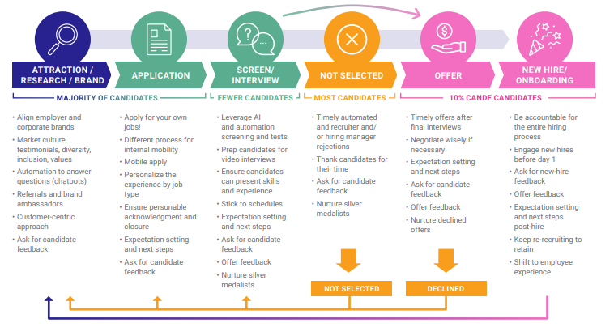
Talent Strategy - Attraction
Talent Attraction TIPS
Design a “Candidate Experience”
Talent Board -2022Candidate Experience Awards
Notes:
Candidate Experience assessment (Resentment up 75% in 2021 – Talent Board)
Candidates who had a bad experience are unlikely to apply again or encourage others to apply.
Recruiters need to own a positive experience
Acknowledge EVERY candidate, even those you reject
Structured selection process – candidates value respect and transparency
Consistent messaging
Timely communications – advance or reject in < 3 days
Timely offers – with one week after the last interview
Don’t wait to “see a few more good people”
Regular check-ins, status updates, any questions, co. news
Keep the interviewing process to 2 interviews, if you have to go to a 3rd, it should be a meet and greet and there should be an offer in hand.

Slide 17
Talent Strategy
Keeping Talent in today’s reality

Slide 18
Talent Strategy - Retention
Talent Retention TIPS
Listening Posts to understand expectations vs experience and collaboratively close gaps
New Employee Interviews
Annual / Pulse surveys
Stay interviews
Focus Groups

Slide 19
Talent Strategy - Retention
Master 4 WE questions
Master 4 ME Questions
I am really enthusiastic about the mission of my company
In my team, I am surrounded by people who share my values
I have the chance to use my strengths every day at work
I know my excellent work will be appreciated
My teammates have my back
I have great confidence in my company’s future
In my work, I am always challenged to grow
At work, I clearly understand what is expected of me

Slide 20
Talent Strategy - Retention
Nine Lies
Nine Truths
People care about which company they work for
The best plan wins
The best companies cascade goals
The best people are well rounded
People need feedback
People can reliably rate other people
People have potential
Work-Life balance matters most
Leadership is a thing
People care which team they are on and who they work for
The best intelligence wins
The best companies cascade meaning
The best people are spiky
People need attention
People can reliably rate their own experience
People have momentum
Love-in-work matters most
We follow spikes

Slide 21
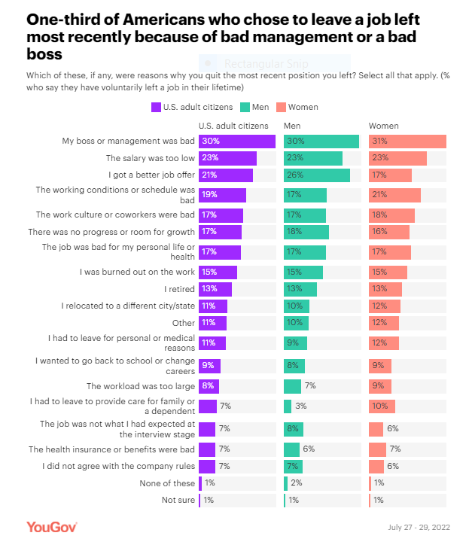
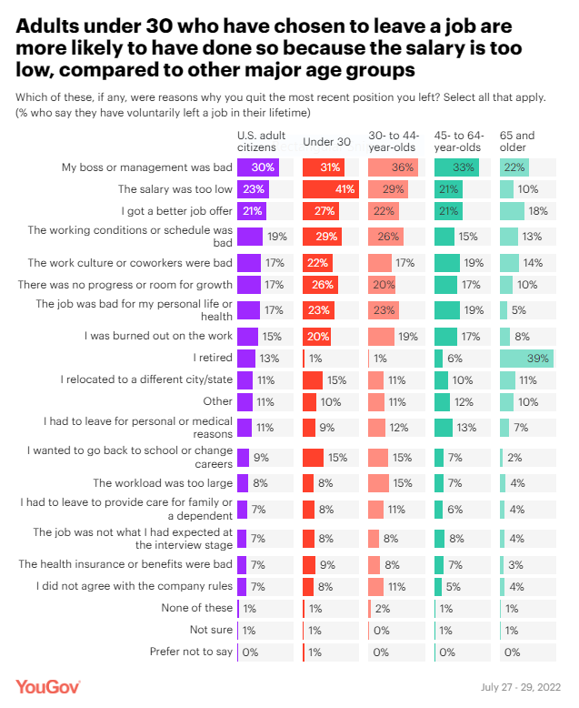
Talent Strategy - Retention

Slide 22
Talent Strategy - Retention
Talent Retention TIPS
Manager training (70/20/10)
Managers must own turnover and engagement like any other business issue
First time managers have a high failure rate (promote the best operator)
Effective team building
People join the company, but stay based on the team/boss
The employee experience is local
Managers must be equipped with tools to:
Build trust and rapport
Set clear priorities
Manage performance
Raise the bar
Push work down
Weekly Check-In between manager/employee
What are your priorities this week?
How can I support you?

Slide 23
Talent Strategy - Retention
Talent Retention TIPS
Goal Setting
Cascading directives that dictate what I “must do” don’t inspire committment
Communicate what hill we are trying to take and why
Equip with information and intelligence (data)
Allow people to participate in deciding how they can contribute
Give attention freely
Ignoring performance leads to disengagement: 20 engaged:1 engaged
Negative attention increases engagement 2:1
Positive attention increase engagement 60:1 vs. ignoring
Make a conscious habit to find what they are doing best (strengths) and communicate what you experienced

Slide 24
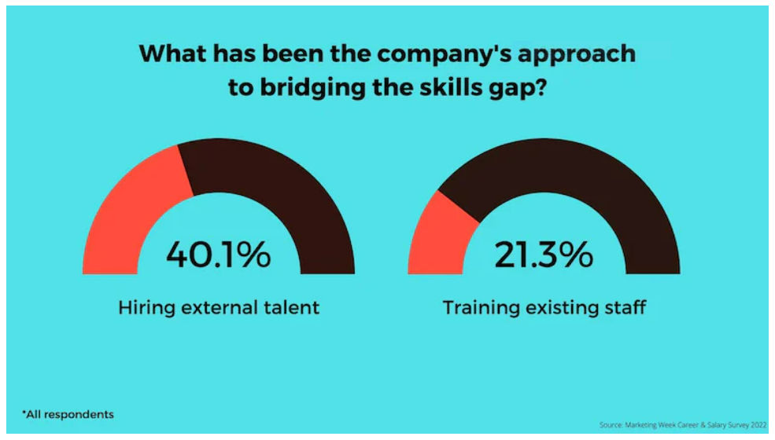
Talent Strategy - Develop
Talent Development TIPS
Annual Career Discussions
How do we turn the best of your job (strengths) into most of your job
Individual Development
70% Experiential
20% Mentoring/Coaching
10% Training

Slide 25
Talent Strategy
Developing Talent in today’s reality

Slide 26
Talent Strategy - Develop
Talent Development TIPS
Workforce Planning – Long Term
How will work be done in your industry in the future
What is your sourcing strategy for having access to what you need, when
Buy, Rent, Grow, Automate
Foundational Skill Categories
Human skills (communication, critical thinking, management
Digital Skills – data analysis
Business Enablement – project management, data communication

Slide 27
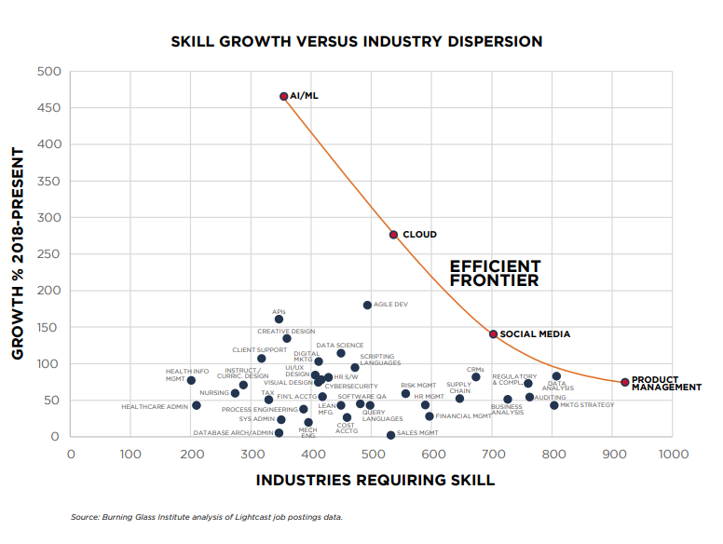
Talent Strategy - Develop
Talent Development TIPS
Emerging Skills
Abandon the on-demand model
Jobs with emerging skills have rapidly growing demand and short supply.
Develop internal / external pipelines
Feeder Jobs
Web designer to product development
Work with education to develop learning pathway
Foster a culture of lifelong learning

Slide 28
Talent Strategy - Develop
Talent Development TIPS
Develop a talent strategy
Buy, Build, Rent, or Automate to get the requisite skills at the capacity and pace required by the organization strategy
Collaboration / Partnerships
Institutions
Workforce Development Board
Industry Associations
Culture of Lifelong learning
Apprenticeships
Learning Platforms (70/20/10)

Slide 29
Talent Acquisition and Retention
Even if we do everything perfect, the raw numbers are not in our favor.
The next 10 years of labor force trends and technological advancement are going to make the past 10 years look easy.
Invest in technology and productivity before your competition beats you to it.
Prepare you workforce for how you will compete in the future

Slide 30
Talent Acquisition and Retention
Recommended Resources
The Burning Glass Institute - Research institute on the future of work and workers. Work with educators, employers, and policymakers to develop talent solutions
CandE Research Reports - Talent Board (thetalentboard.org) – 150 companies and 200,000 candidates. Benchmark experiences from pre-application through onboarding. See what the award winners are doing better
Nine Lies About Work: A Freethinking Leader’s Guide to the Real World: Buckingham, Marcus, Goodall, Ashley: 9781633696303: Amazon.com: Books

