Slide 1
Preparing Employers for the Affordable Care Act
Kimberly A. Nash, MBA, SPHR, CMS
Director of Human Resource Services
Brown & Brown of Pennsylvania (Alpha Benefits Division)
November 2014

Slide 3
Disclaimer
Brown & Brown of PA provides a variety of business advisory consulting services for its clients. Brown & Brown of PA does not, however, provide legal services and does not employ individuals licensed or competent to practice law in any jurisdiction. Therefore, any services or information provided by Brown & Brown of PA are not legal opinions or legal advice. If legal advice, counsel, or representation is needed, the services of a competent legal professional should be sought.

Slide 4
Are You Prepared?
Taxes
90-Day Waiting Periods (2014)
Determining Group Size
Requirements by Group Size
Variable Hour Employees
Government Reporting Requirements

Slide 5
Taxes
PCORI Tax
1st year $1 per covered person, 2nd year $2, 3rd Year $2.08
Fully Insured, carrier submits tax
Self-insured & HRA/MERP* use Form 720

Slide 6
Taxes
Transitional Reinsurance
Fully insured plans, carrier will submit
2014 due in 2015 - $63 per person (200 * 63 = $12,600)
Self-insured will submit in two installments
$52.50 due by mid January 2015
$10.50 due by 4th quarter 2015
Registration by November 15 pay.gov
First bill will arrive by December 15
Retain records for 10 years

Slide 7
Cadillac Tax
Effective 2018
A 40% excise tax on the value of health insurance exceeding $10,200 (single) and $27,500 (family) – (may be adjusted)
If the plan is self-insured, we expect that the COBRA rate will be used
If the plan is fully insured with an HRA, we expect that the COBRA rate will be used
If the employer has an HSA, the employer contribution is included, but if the employer makes an after tax contribution to the HSA, it would not be included (most plans are not currently set up this way)
If the employee contributes pre-tax to his/her HSA, it is uncertain at this time but it is believed that the IRS is leaning towards it be counted toward the value

Slide 8
90-Day Waiting Periods
All group health plans no longer than 90 days (2014)
All calendar days must be counted
Variable Hour Employee Measurement Period
One-time Cumulative Service requirement (1200 hours)
Orientation Period prior to 90-day period
Cannot be used to avoid the 90-period
Seek legal counsel to use cumulative or orientation period
Fine is $100 per day per individual!

Slide 9
Determining Group Size
Based on calendar year, can use a consecutive 6 month period in 2014
Less than 50 full-time employees including full-time equivalents.
At least 50 full-time employees but less than 100 full-time employees including full-time equivalents.
At least 100 full-time employees including full-time equivalents.
Full-time is defined as paid for 30 hours per week. (Includes PTO)
Aggregate hours of part-time employees for 1 month/120 hours + full-time employees (Employer with a workforce of 50 or more full-time employees for 120 days or fewer as a result of seasonal workers are not an applicable large employer)

Slide 10
Requirements by Group Size
Less than 50 full-time employees including full-time equivalents
Employers are not an applicable large employer and are not subject to penalties for not offering health insurance coverage
Small group health plans must comply with regulations
May be able to keep your non-compliant plan for another year
Small group health plans are subject to taxes
Must use SHOP to take the tax credit

Slide 11
Requirements by Group Size
At least 50 but less than 100 full-time employees
including full-time equivalents
Must offer affordable and MVC to employees who are paid for 30 hours per week
Must offer MVC to dependents (spouses, foster children, and step children may be excluded)
May have transition relief until 2016 plan year
May not reduce workforce between 2/9/14 and12/31/14 to meet workforce size
Does not eliminate or materially reduce health coverage offered as of 2/9/14
Employers must certify to the IRS that they meet eligibility for transition relief

Slide 12
Requirements by Group Size
At least 100 full-time employees including full-time equivalents
Must offer affordable and MVC to employees who are paid for 30 hours per week
Must offer MVC to dependents (spouses, foster children, and step children may be excluded)
May have transition relief until start of 2015 plan year
Must offer coverage to at least 70%* of eligible employees; 95% in 2016
Failure to offer coverage, penalty will apply to all full-time employee minus 80 in 2015; 30 in 2016
* Penalty may apply for individuals who go to the exchange and receive subsidy

Slide 13
Transition relief
Non- Calendar Year Plans
Must have had the plan on 12/27/12
Plan year was not modified after 12/27/12
For the 12 month period ending 2/9/14
On a date,1/4 of all employees were covered OR 1/3 of all employees offered coverage at the most recent open enrollment
OR
On a date, 1/3 of full-time employees were covered OR ½ of full-time employees were offered coverage at the most recent open enrollment

Slide 14
Affordable coverage
Employee contribution toward employee only coverage cannot exceed 9.5% of their wages.
Employer can offer multiple plans, only one plan has to be affordable.
Safe Harbor:
Box 1 of W-2 wages for the current year
Rate of Pay: $7.25 x 130 hours x 12 = $11,310 x 9.5% = $1,074.45 annual or $89.54/month
Based on Federal Poverty Level – currently $11,670* for individual * 9.5% = $1,108.65/year or $92.39/month
*2014

Slide 15
Minimum Value coverage
Plan covers at least 60% of the total allowed benefits
Employer contributions to HSA can be included
Annual contributions toward MERP/HRA that are integrated with a health plan count toward the 60%
Health Insurance Carriers identifying plans
Bronze = 60%
Silver = 70% (subsidies are based on this level)
Gold = 80%
Platinum = 90%

Slide 16
Penalties
Penalty A
Applicable Large Employers must offer affordable and MVC to full-time employees and MVC coverage to their children.
Employer will be charged a penalty (calculated monthly) per full-time employee if no coverage is offered and if one employee goes to the exchange and receives a subsidy.
The first 30 employees are “free,” no penalty assessed. (80 employees in 2015)
Annual penalty beginning in 2015 may be more than $2,000.
The penalty is a non-deductible business expense
70% of full-time employees must be offered coverage in 2015; 95% of employees in 2016

Slide 17
Penalties
Penalty B
Employer sponsored health insurance that is not affordable and/or does not meet MVC
Penalty applies for each full-time employee who goes to the exchange and receives a subsidy
Penalty is capped
Penalty is calculated monthly and may be more than $3,000 in 2015.
Subsidy is based on employee’s household income. Employee may be eligible for a subsidy on the exchange but employer may not be assessed a penalty if the employee’s contribution met the affordability requirement
Penalty is a non-deductible business expense

Slide 18
Variable Hour Employees
Part-time Employees (do not have a regular schedule)
Per Diem Employee/On-call Employees
Partial Year Employees who don’t meet the seasonal definition
Seasonal employee is in a customary annual position for 6 months or less
Begins at approximately at the same time each year (retail, ski resort, agricultural, etc.)

Slide 19
Variable Hour Employees
Standard Measurement Period
Administrative Period
Stability Period
Initial Measurement Period

Slide 20
Variable Hour Employees
On-going Employee
Safe Harbor
Standard Measurement Period 3 – 12 months, employer establishes
Stability Period at least 6 months and same length of measurement period
Administrative period no more than 90 days
Transitional relief for 2015 for plans that renew early in the year (shorter than 12 month measurement period, but measurement period must begin by July 2014)

Slide 21
Variable Hour Employees
New Variable Hour Employee
Safe Harbor
At the time of hire, unsure if employee meets full-time requirement (30 hours)
Initial Measurement Period 3 – 12 months, employer establishes
Stability Period at least 6 months and same length of measurement period
Administrative period no more than 90 days
Combined measurement and administrative periods cannot exceed 13 months and a fraction of a month. The final day of the first calendar month on or after the employee’s one year anniversary.

Slide 22
Variable Hour Employees
Calendar Year Plan Example with transition relief in 2014

Slide 23
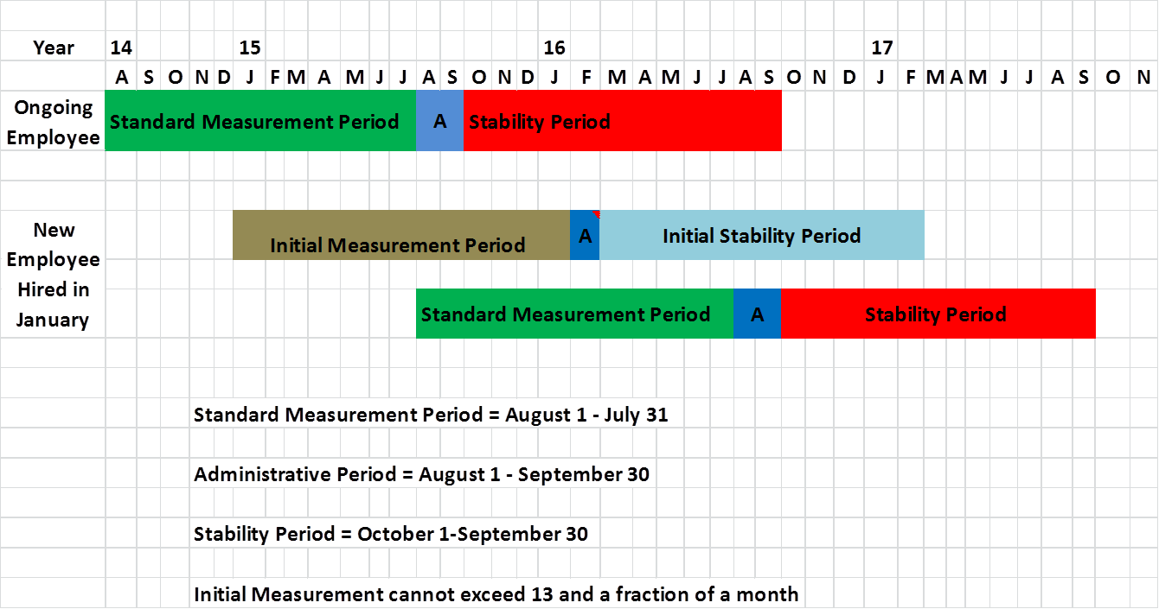
Variable Hour Employees
Fiscal Year Plan Example (October)

Slide 24
Variable Hour Employee

Slide 25
Government Reporting
W-2 Reporting of Health Benefit Costs for employers that issued 250 or more W-2s.
Summary of Benefits and Coverage (SBC) plan years beginning after 9/23/12
Notice of Exchanges to be distributed to employees by 10/1/13. New employees with 14 days from date of hire.
Self-insured plans submit information for transitional reinsurance fee by November 15 annually beginning in 2014. Pay.gov to register

Slide 26
Government Reporting
Insurers/Plan Sponsor report information to the IRS about coverage all plans (6055)
Employers with 50 of more FTE report health plan and employee information to the IRS – March 1, 2016 (6056)
Statement to Employees that information has been sent to IRS – February 1, 2016
All employers (50+) must report 2015 information, no transition relief

Slide 27
Questions
Kim Nash
800-335-6968 x 107
kn@alphabenefits.com

