Slide 1
Fatigue & Worker Safety
Bureau of Workers’ Compensation
PA Training for Health & Safety (PATHS)
Notes:
Fatigue is an increasing health and safety problem in our daily lives due to the 24-hour society with decreasing emphasis on sleep. Employers are becoming increasingly aware that fatigue is a safety issue, they along with workers play an important role in tackling this problem. The key is to be proactive and to get buy in from the top down. It is important to talk about fatigue and how it can impact all aspects of our lives, not just at work. Fatigue is a workplace hazard because it affects your ability to think clearly and act appropriately. Fatigued workers are less alert, don’t perform well, are less productive and are more likely to have accidents and injuries.

Slide 2
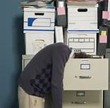
Overview
Definition
Causes & Effects
Statistics
Solutions
Risk Management
Notes:
Overview
Definition
Causes & Effects
Statistics
Solutions
Risk Management

Slide 3
Definition
Fatigue – The body’s response to sleep deprivation or lengthy physical or mental hard work.*
*American College of Occupational & Environmental Medicine
Notes:
A 2012 guidance statement from the American College of Occupational and Environmental Medicine defines fatigue as the body’s response to sleep deprivation or lengthy physical or mental hard work.

Slide 4
Physical Fatigue
Physical fatigue or muscle fatigue is the temporary physical inability of a muscle to perform optimally.
Notes:
Physical fatigue or muscle fatigue is the temporary physical inability of a muscle or muscles to perform optimally.
Wikipedia
https://en.wikipedia.org/wiki/Fatigue_(medical)

Slide 5
Mental Fatigue
Mental fatigue is the temporary inability to maintain optimal cognitive performance.
Notes:
Mental fatigue is the temporary inability to maintain optimal cognitive performance.
Wikipedia
https://en.wikipedia.org/wiki/Fatigue_(medical)

Slide 6
Fatigue vs Sleepiness
Fatigue is generally considered a more long-term condition than sleepiness.
Sleepiness is the tendency to fall asleep; fatigue is the body’s response to sleep loss or prolonged physical or mental exertion.
Notes:
Fatigue is generally considered a more long-term condition than sleepiness. Sleepiness is the tendency to fall asleep; fatigue is the body’s response to sleep loss or prolonged physical or mental exertion.

Slide 7
Causes & Effects
Causes
Long work hours
Heavy workloads
Lack of sleep
Environmental factors
Medical conditions
Multiple jobs
Notes:
Risk factors related to occupational fatigue include:
Long work hours
Heavy workloads
Lack of sleep
Environmental factors
Medical conditions
Multiple jobs
Even dealing with other people can result in fatigue. You can become fatigued simply by going to work and having really poor social interactions with your co-workers. It is not just about how much sleep you get.
Many people work multiple jobs, leaving them vulnerable to fatigue. People who work several jobs get 40 minutes less sleep per day than those who work one job, according to David Lombardi, principal research scientist at the Center for Injury Epidemiology at the Liberty Mutual Research Institute for Safety in Hopkinton, MA.

Slide 8
Causes & Effects
Causes
Mental stress
Overstimulation
Understimulation
Jet lag
Depression
Active recreation
Boredom
Notes:
Taking an honest inventory of things that might be responsible for your fatigue is often the first step toward relief. Fatigue may be related to:
Mental stress
Overstimulation
Understimulation
Jet lag
Depression
Active recreation
Boredom

Slide 9
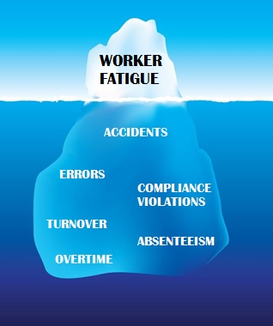
Causes & Effects
Effects
Slower reaction time
More errors/mistakes
Decreased cognitive ability
Notes:
Effects of fatigue can include:
Slower reaction time
More errors/mistakes
Decreased cognitive ability

Slide 10
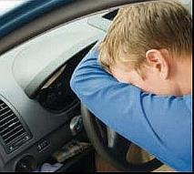
Industries
Fatigue can occur in all industries; however, some industries have higher risks:
Shift workers
Health care
Drivers
Industries with long work hours
Industries with overtime
Industries that expose workers to harsh environmental conditions
Notes:
Fatigue can occur in all industries, but numerous studies have focused on its effects on shift workers, health care workers and drivers.
The industries that are at the highest risk would be those where people are working long hours, overtime, many days in a row and when they’re exposed to harsh environmental conditions such as working outside in the rain or snow.

Slide 11
Environmental Conditions
Weather
Noise
Vibrations
Heavy mental task loads for long periods of time
Notes:
Environmental conditions can include things like noise or vibrations and really heavy mental task loads for long periods of time. You can extend to what industries that describes, like electrical transmission and distribution line workers or people who drive snowplows.

Slide 12
Statistics
Usual hrs. slept/day
< 4.99
5-5.99
6-6.99
7-7.99
8-8.99
9-9.99
> 10
Estimated annual injury incidence per 100 workers
7.89
5.21
3.62
2.27
2.50
2.22
4.72
Notes:
The estimated annual injury incidence rate per 100 workers is 7.89 for US workers who usually sleep less than five hours per day, compared with 2.27 per 100 workers among those who tend to sleep between seven and eight hours.
Most adults need 7 to 9 hours of uninterrupted sleep every 24 hours, preferably during the hours of darkness.
Sleep debt builds up when someone regularly has less sleep than they need, and sleep debt leads to fatigue.
Source: Lombardi DA, Folkard S, Willets JL, Smith GS. “Daily sleep weekly working hours, and risk of work-related injury: US National Health Interview Survey (2004-2008).” Chronobiology International, 2010 July: Vol. 27 No. 5.

Slide 13
Statistics
38% of U.S. workers sleep less than 7 hours a night.*
Workers who have a sleeping disorder are more likely to be involved in a workplace safety incident.*
Fatigue-related productivity losses cost almost $2,000 per worker each year.#
* According to NIOSH # According to Cupertino, CA-based Alertness Solutions
Notes:
The National Safety Council has launched an initiative on occupational fatigue. The National Safety Council has gathered research with the aim of identifying best practices. As a result of the study NSC discovered that:
38% of U.S. workers sleep less than 7 hours a night.
Workers who have a sleeping disorder are more likely to be involved in a workplace safety incident.
Fatigue-related productivity losses cost almost $2,000 per worker each year. – According to Cupertino, CA-based Alertness Solutions
Fatigue has always been a problem – there’s always been shift work, people have always not gotten their full night’s rest. Occupational fatigue has started to come to light more in the past 20 years, when the research really started showing it was causing unsafe work practices and increasing risk in the workplace.

Slide 14
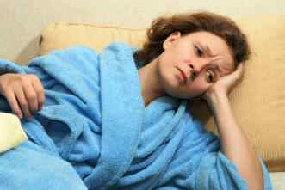
Statistics
Lack of sleep results in a 13% increased risk of death.*
Lack of sleep results in the loss of 1.2 million workdays per year.*
* RAND Corporations
Notes:
A report from RAND Europe, part of the non-profit research organization RAND Corp., concluded that lack of sleep results in a 13% increased risk of death and the loss of 1.2 million workdays per year.

Slide 15
Solutions
Taking breaks
Adopting better sleep habits
Understand the importance of sleep; promote it
Create brighter workplaces with settings for naps
Deter lengthy use of electronic devices after work
Notes:
Although workers can help prevent fatigue through measures such as taking breaks and adopting better sleep habits, employers can also help combat the issue of fatigue as well.
Picture: HelpGuide.org

Slide 16
More Solutions
Working during the day rather than at night
Restricting consecutive day shifts to five or six days and night shifts to four days
Ensuring workers have at least two consecutive days off
Making schedules consistent
Providing frequent breaks
Notes:
According to a Liberty Mutual report, recommendations for scheduling include:
Working during the day rather than at night
Restricting consecutive day shifts to five or six days and night shifts to four days
Ensuring workers have at least two consecutive days off
Making schedules consistent
Providing frequent breaks
Picture: STEAM Register

Slide 17
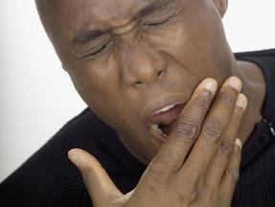
Signs
Supervisors should be alert for signs of excessive fatigue such as:
Yawning
Head dropping
Difficulty remembering or concentrating
Notes:
Supervisors should be alert for signs of excessive fatigue among workers, such as yawning, head dropping and difficulty remembering or concentrating.

Slide 18
Risk Management
Reporting of fatigue-related incidents
Investigation
Training for employees on fatigue and managing sleep disorders
Auditing
Are sleep disorders covered on the insurance plan?
Notes:
A risk management system can help mitigate fatigue. A risk management system can include:
Reporting of fatigue-related incidents
Investigation
Training for employees on fatigue and managing sleep disorders
Auditing
Are sleep disorders covered on the insurance plan?

Slide 19
Risk Management
Taking breaks
Caffeine
Changing environmental factors
Do not consume alcohol before bedtime
Moving safety-sensitive work to other employees or another time to take advantage of alertness
Notes:
Even if a company chooses not to invest in a complex risk management system it can share messages about fatigue through toolbox safety talks to pass important information onto employees such as:
Taking breaks
Caffeine
Changing environmental factors
Do not consume alcohol before bedtime
Moving safety-sensitive work to other employees or another time to take advantage of alertness
Although workers are responsible for being well-rested, managers should provide information, motivation and resources on fatigue.

Slide 20
Risk Management
Improve lighting
Minimizing humidity
Minimizing monotonous noise
Minimizing vibration
Making sure the temperature is cooler – especially at night
Notes:
Being aware of how your workplace is set up and how the work is handled will help decrease the risk of a fatigue-related injury.
Improve lighting
Minimizing humidity
Minimizing monotonous noise
Minimizing vibration
Making sure the temperature is cooler – especially at night
As employers are looking at redesigning workplaces or building new ones, these are things that can be put into place at the beginning or during retrofit to help minimize fatigue related injuries.

Slide 21
Risk Management
Balancing workload and staffing
Shift scheduling
Workplace design/redesign
Monitoring of fatigue
Notes:
Some other critical elements of a good risk management system include a good fatigue policy/procedure, risk management, reporting, incident investigation, training and education and auditing. Key defenses of a fatigue risk management system are:
Balancing workload and staffing
Shift scheduling - Shift work may encompass several aspects of work scheduling. This may include working hours outside of what would be considered “normal” daytime hours such as between 7 AM and 6 PM, overtime work (beyond a 40-hourworkweek), or extended shifts
Workplace design/redesign
Monitoring of fatigue

Slide 22
Training
Fatigue related hazards
Sleep disorders
Diet
Exercise
How to get adequate and quality sleep
How to recognize fatigue
Notes:
Medical and lifestyle interventions as well as organization factors can help promote alertness. Employers can help promote the prevention of fatigue-related injuries by training employees on:
Fatigue related hazards
Sleep disorders
Diet – Drinking water and eating healthy snacks can boost energy
Exercise
How to get adequate and quality sleep
How to recognize fatigue

Slide 23
Getting a Good Night’s Sleep
Tips for getting a good night’s sleep
Repay your debt - The lack of enough sleep over time can result in a sleep debt.
This is the difference between the amount of sleep you need and the amount you get.
This debt can be repaid by tacking on extra time each night until you feel caught up.
Notes:
Tips for getting a good night’s sleep
Repay your debt - The lack of enough sleep over time can result in a sleep debt. This is the difference between the amount of sleep you need and the amount you actually get. This debt can be repaid by tacking on extra time each night until you feel caught up.

Slide 24
Getting a Good Night’s Sleep
Exercise by Day to Sleep at Night - Regular exercise can help you sleep better.
For best results, exercise outside before dinner. But don't rev up with exercise near bedtime.
In the evening, light yoga or stretches can help you wind down.
If you have a medical problem or are over 50 check with your doctor before starting an exercise routine.
Notes:
Exercise by Day to Sleep at Night - Regular exercise can help you sleep better. For best results, exercise outside before dinner. But don't rev up with exercise near bedtime. In the evening, light yoga or stretches can help you wind down. If you have a medical problem or are over 50 check with your doctor before starting an exercise routine.

Slide 25
Getting a Good Night’s Sleep
Choose Evening Snacks Wisely - An oatmeal raisin cookie and a glass of milk can help you fall asleep.
That's because this snack includes complex carbs that likely increase levels of sleep-inducing amino acid tryptophan. Other sleep-boosting choices: a piece of whole grain toast or a small bowl of cereal.
Notes:
Choose Evening Snacks Wisely - An oatmeal raisin cookie and a glass of milk can help you fall asleep. That's because this snack includes complex carbs that likely increase levels of sleep-inducing amino acid tryptophan. Other sleep-boosting choices: a piece of whole grain toast or a small bowl of cereal.

Slide 26
Getting a Good Night’s Sleep
Get on a Sleep Schedule - The average person needs 7-9 hours of sleep per night.
Most experts recommend maintaining a consistent sleep schedule even on days when you can sleep in.
This balances a person's internal clock, allowing them to stay awake when needed and fall asleep when ready.
It helps if your bedroom is conducive to sleep: dark, cool, and quiet.
Notes:
Get on a Sleep Schedule - The average person needs 7-9 hours of sleep per night. Most experts recommend maintaining a consistent sleep schedule even on days when you are able to sleep in. This balances a person's internal clock, allowing them to stay awake when needed and fall asleep when ready. It helps if your bedroom is conducive to sleep: dark, cool, and quiet.

Slide 27
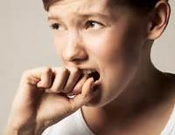
Getting a Good Night’s Sleep
Wind Down Your Brain - Try blocking out a daily "worry time" to get anxiety out of your system before bed.
Make time just after dinner to plan your next day, catch up on email, and tie up loose ends. Then you can have time before bed to let go of anxieties and relax.
Notes:
Wind Down Your Brain - Try blocking out a daily "worry time" to get anxiety out of your system before bed. Make time just after dinner to plan your next day, catch up on email, and tie up loose ends. Then you can have time before bed to let go of anxieties and relax.

Slide 28
Getting a Good Night’s Sleep
If You Nap, Keep it Short - Whether you should nap during the day depends on how you normally sleep at night.
If you typically sleep well, then an occasional short nap is OK.
Naps can make you function better, lower blood pressure, and maybe even help you live longer.
Avoid napping too late in the day, as it might affect your nighttime sleep.
But if you have sleep problems, naps may mess up your sleep schedule even more.
Notes:
If You Nap, Keep it Short - Whether you should nap during the day depends on how you normally sleep at night. If you typically sleep well, then an occasional short nap is OK. Naps can make you function better, lower blood pressure, and maybe even help you live longer. Avoid napping too late in the day, as it might affect your nighttime sleep. But if you have sleep problems, naps may mess up your sleep schedule even more.

Slide 29
Getting a Good Night’s Sleep
Avoid Hidden Sleep Wreckers - Caffeine can perk you up so avoid it after lunch if you have trouble sleeping at night.
It can stay in your system for an average of three to five hours, but some people are affected for as much as 12 hours.
Watch your afternoon food and drink choices.
Caffeine may hide in soft drinks, tea, and chocolate.
Also be wary of certain medications, such as decongestants, which can aggravate sleep problems.
Notes:
Avoid Hidden Sleep Wreckers - Caffeine can perk you up so avoid it after lunch if you have trouble sleeping at night. It can stay in your system for an average of three to five hours, but some people are affected as long as 12 hours. Watch your afternoon food and drink choices. Caffeine may hide in soft drinks, tea, and chocolate. Also be wary of certain medications, such as decongestants, which can aggravate sleep problems.

Slide 30
Getting a Good Night’s Sleep
Natural Ways to Help You Sleep - Some people try natural methods to wind down their day.
Used medicinally for thousands of years, chamomile brewed in tea is non-caffeinated and may help relax you for sleep.
Or try aromatherapy. Studies have found that lavender produces slight relaxing and calming effects when inhaled.
For some people, melatonin seems to improve sleep. If you take medications, talk with your doctor before taking any supplement.
Notes:
Natural Ways to Help You Sleep - Some people try natural methods to wind down their day. Used medicinally for thousands of years, chamomile brewed in tea is non-caffeinated and may help relax you for sleep. Or try aromatherapy. Studies have found that lavender produces slight relaxing and calming effects when inhaled. For some people, melatonin seems to improve sleep. If you take medications, talk with your doctor before taking any supplement.

Slide 31
Getting a Good Night’s Sleep
Try Relaxation Exercises - In the late evening, visualize something calming, using all your senses to make the image as vivid as possible.
Or try progressive muscle relaxation.
Tighten up the muscles in your toes for several seconds. Then relax them for 30 seconds.
Focus on how relaxed they feel. Repeat this all the way up your body, ending at your neck and face.
Notes:
Try Relaxation Exercises - In the late evening, visualize something calming, using all your senses to make the image as vivid as possible. Or try progressive muscle relaxation. Tighten up the muscles in your toes for several seconds. Then relax them for 30 seconds. Focus on how relaxed they feel. Repeat this all the way up your body, ending at your neck and face.

Slide 32
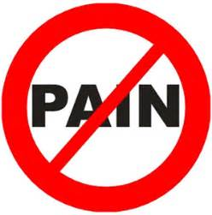
Getting a Good Night’s Sleep
When You're in Pain - You may want to consider taking a nighttime pain reliever to help you doze off, but consult your doctor if pain commonly keeps you up at night.
Notes:
When You're in Pain
Are aches and pains keeping you up at night? You’re not alone: According to one survey, three-quarters of people with low back pain experienced poor sleep. And if you can’t sleep well, you may feel even worse during the day. First, make sure you practice good sleep hygiene. You may want to consider taking a nighttime pain reliever to help you doze off, but consult your doctor if pain commonly keeps you up at night.

Slide 33
Getting a Good Night’s Sleep
See a Doctor About Sleep Problems
If you have sleep problems and none of these strategies helps, you may have a sleep disorder.
Medications and some medical conditions can cause sleep problems.
Your doctor or a sleep specialist can help you find the problem and learn ways to improve sleep.
Notes:
See a Doctor About Sleep Problems
If you have sleep problems and none of these strategies helps, you may have a sleep disorder. Medications and some medical conditions can cause sleep problems. Your doctor or a sleep specialist can help you find the problem and learn ways to improve sleep.

Slide 34
Contact Information
Health & Safety Training Specialists
(717) 772-1635
RA-LI-BWC-PATHS@pa.gov
Upcoming PATHS Webinars
Request for Topic Resources
Notes:
Upcoming PATHS Webinars available in PATHS Training Calendar: PATHS Training Calendar
https://www.dli.pa.gov/Businesses/Compensation/WC/safety/paths/calendar/Pages/default.aspx
Request for Topic Resources available in PATHS Resource Request Order Form: PATHS Resource Request (office.com)
https://forms.office.com/Pages/ResponsePage.aspx?id=QSiOQSgB1U2bbEf8Wpob3mV1QUieF2dOqe6x_REn8adUMVg5UFJGNERQOUVGVDBEMzBRRUVLT0dMUC4u&wdLOR=cE2B7533D-009F-F945-B098-8007B419885F

Slide 35
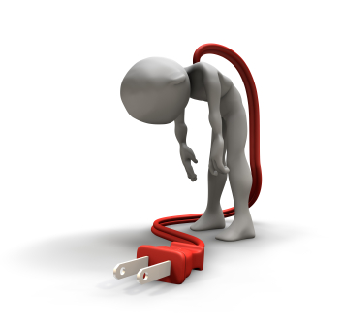
Questions

Slide 36
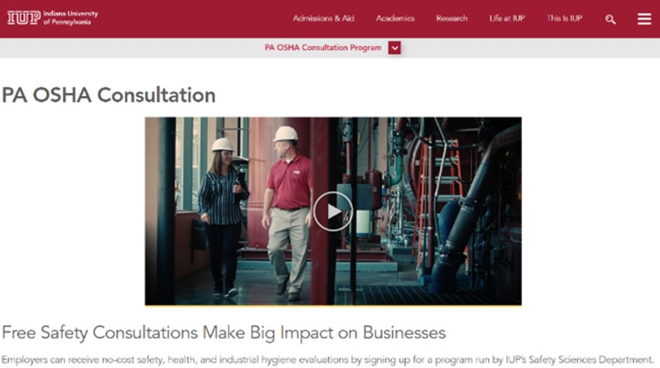
IUP OSHA Consultation Program
Telephone Number 1-724-357-4095
Link for additional information
36
Notes:
Website for additional information on Pennsylvania’s OSHA Consultation Program run by the Indiana University of Pennsylvania’s Safety Sciences Department: https://www.iup.edu/pa-oshaconsultation/
Since 1983, the Safety Sciences Department of Indiana University of Pennsylvania has been the officially designated agency in the Commonwealth of Pennsylvania for providing FREE occupational and health consultative services made available through federal regulations.​
​
The program is designed to assist private-sector employers with OSHA compliance efforts.​
For employers with 250 or fewer employees at any one site and 500 or fewer employees in total, full OSHA compliance assistance is available.​
For larger employers, service is available, but will probably be for a limited scope.​
All PA businesses are welcome to call with OSHA-related questions.

Slide 37
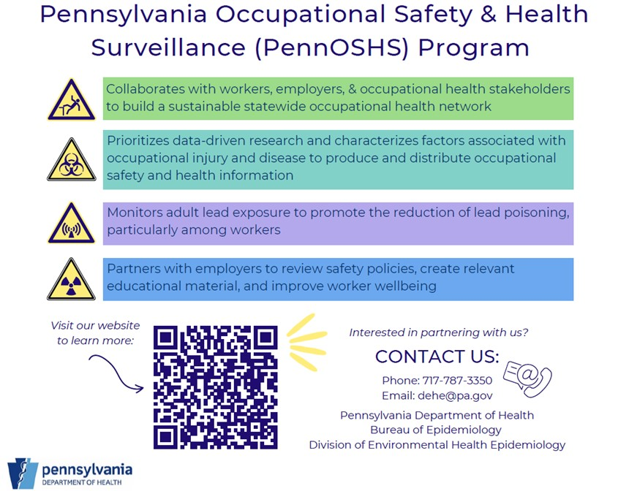
PennOSHS Program
Link to website for
additional
information
Notes:
Website for additional information on Pennsylvania’s OSHA Consultation Program run by the Indiana University of Pennsylvania’s Safety Sciences Department: https://www.iup.edu/pa-oshaconsultation/

Slide 38
Pennsylvania’s GASE Award
Are you proud of your safety program?
Does it go above and beyond?
If so, we want to
hear from you.
Apply from
January 1st to May 1st to be recognized for our state’s highest safety honor.
Link for additional information
Notes:
Website for additional information on Pennsylvania’s Governor’s Award for Safety Excellence: https://www.dli.pa.gov/Businesses/Compensation/WC/safety/gase/Pages/default.aspx

Slide 39
Bibliography
Safety & Health Magazine – National Safety Council March 2017.
Wikipedia
https://en.wikipedia.org/wiki/Fatigue_(medical)
WebMD http://www.webmd.com

Slide 40
Related Presentations
If you are interested in viewing more information regarding worker fatigue we suggest the following PowerPoints which we can send you or you can find on our website:
Stress and Worker Safety
Drug and Alcohol Awareness
http://www.dli.pa.gov/Businesses/Compensation/WC/safety/paths/Pages/default.aspx

